Slide 1
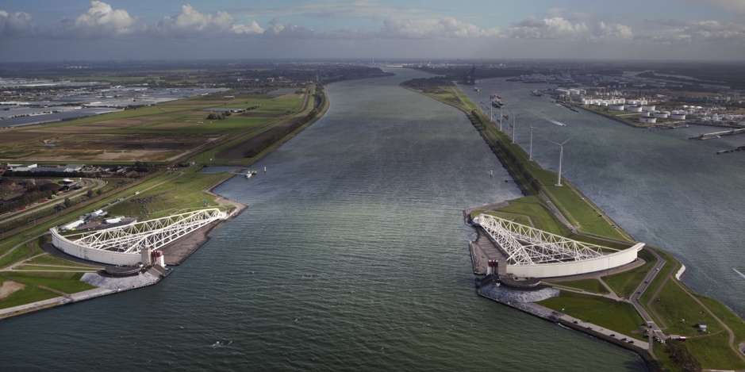
Model-based support for Decision Making under Deep Uncertainty
Prof. dr. ir. Jan H. Kwakkel
Multi-Actor Systems department
Faculty of Technology, Policy and Management

Slide 2
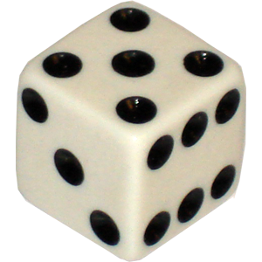
Problem 1
Imagine you are a flood risk manager. You need to decide on an investment in dikes for the coming ten years. You have been given the following information
Chance of a severe flood is 1 in 6
Damage in case of a flood is 1 million
Costs of investment in dikes is 1.3 million
If dikes are built, chance of flood falls below 1 in 50
Assume a 10-year planning horizon
Will you invest in the dikes?

Slide 3

Problem 2
Imagine you are a flood risk manager. You need to decide on an investment in dikes for the coming ten years. You have been given the following information
According to a first group of experts, the chance of a severe flood is 1 in 6
According to a second group of experts, the chance of a severe flood is 1 in 10
Damage in case of a flood is 1 million
Costs of investment in dikes is 1.3 million
If dikes are built, chance of flood falls below 1 in 50
Will you invest in the dikes?

Slide 4
So what is deep uncertainty?
Deep uncertainty refers to the situation where the various parties to a decision do not know or cannot agree on
The system model that relates actions to consequences
The prior probability distributions to put on the inputs to the system model(s)
Which consequences to consider and their relative importance
Deep uncertainty often involves decisions made over time in dynamic interaction with the system.
Kenneth Arrow first used the term in the late 1990s to characterize the climate change debate
Formal work on dealing with deep uncertainty started in the early 2000s at the RAND Corporation and TU Delft.
Deep uncertainty is also known as radical uncertainty, Knightian uncertainty, or uncertainty proper

Slide 5
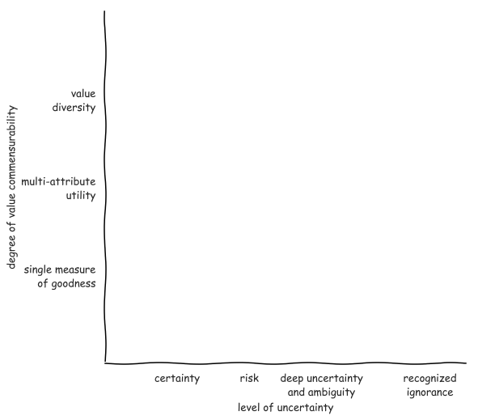
Notes:
Pas op met woord methode
Ontbreken van theorie en effectieve methode

Slide 6
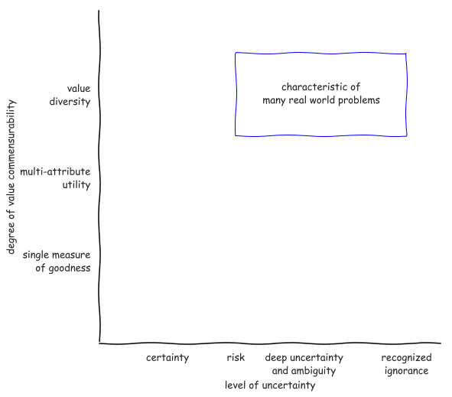
Notes:
Pas op met woord methode
Ontbreken van theorie en effectieve methode

Slide 7
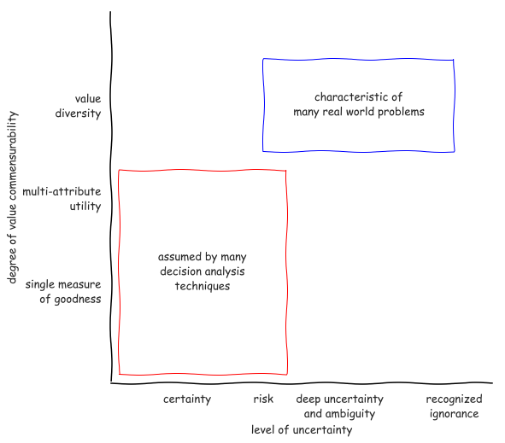
Notes:
Pas op met woord methode
Ontbreken van theorie en effectieve methode

Slide 8
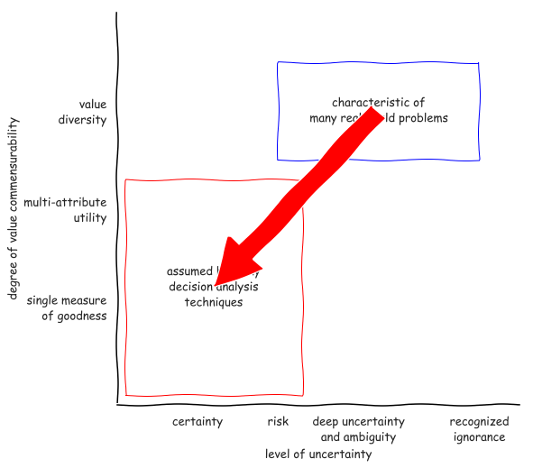
Notes:
Pas op met woord methode
Ontbreken van theorie en effectieve methode

Slide 9
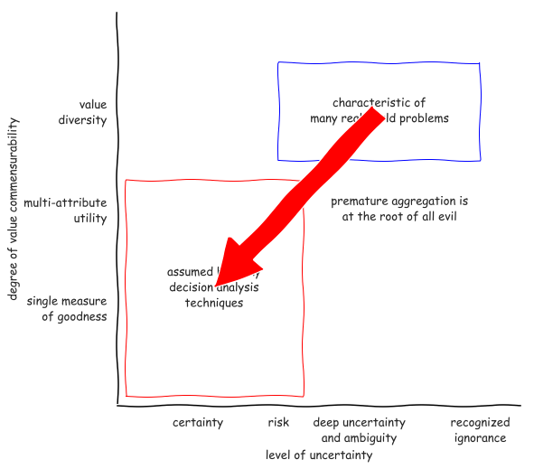
Notes:
Pas op met woord methode
Ontbreken van theorie en effectieve methode

Slide 10
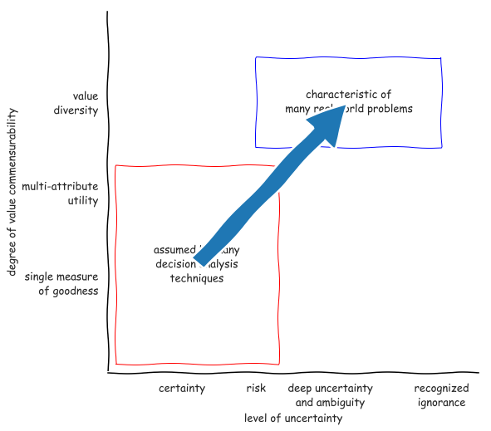
Notes:
Pas op met woord methode
Ontbreken van theorie en effectieve methode

Slide 11

Why use models?
Argument from complexity
supplement human reasoning
sensitivity to initial conditions
Argument from uncertainty
When confronted with uncertainty, instead of making an assumption, explore the consequences of alternative assumptions systematically to identify differences that make a difference
Notes:
Multiplicity of legitimate perspectives
Does l’esprit de geometrie have a place?

Slide 12
Decision-making under deep uncertainty
Decision aiding – the aim of decision advise is to facilitate learning about a problem and potential courses of action, not to dictate the right solution. This entails a shift from a priori to a posteriori decision analysis.
Adaptive planning – plans should be designed from the outset to be adapted over time in response to how the future is unfolding
Exploratory scenario thinking– the future is uncertain and cannot be probabilistically constrained, we need systematic what-if analysis of the future which serves as a test bed for candidate strategies

Slide 13
Aiding decision making

Slide 14

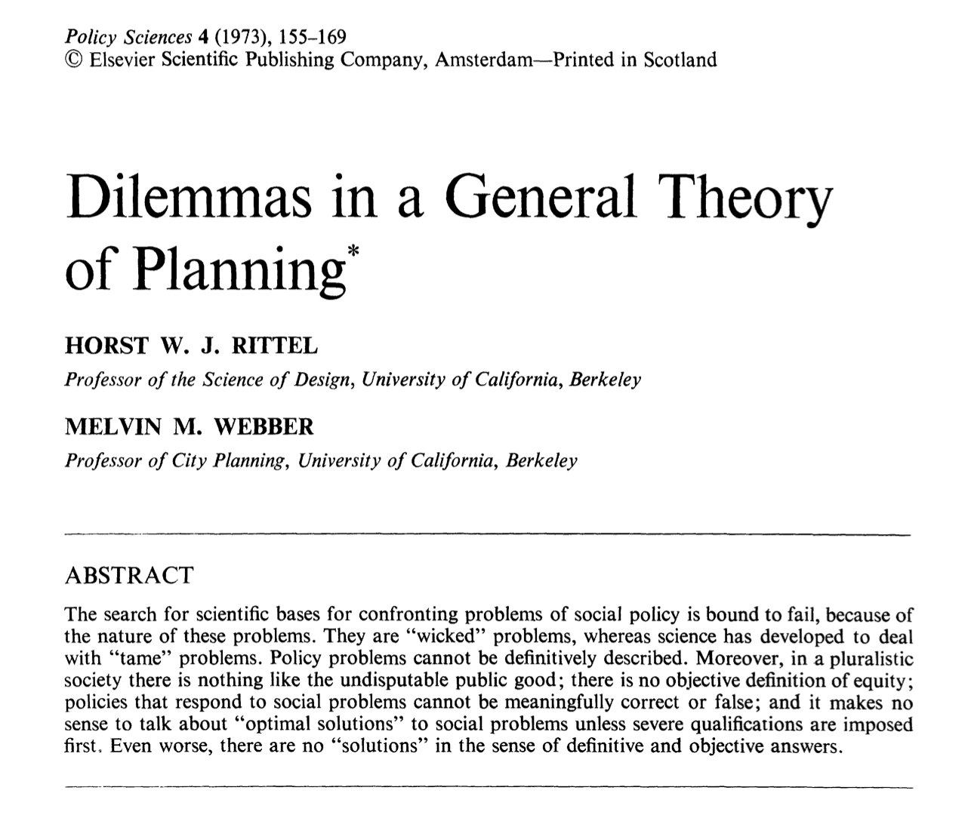
What is the role of models in decision making?
Notes:
The task of an adaptive organism is to find the difference between an existing state and a desired state and then find the correlating process that will erase the difference.

Slide 15

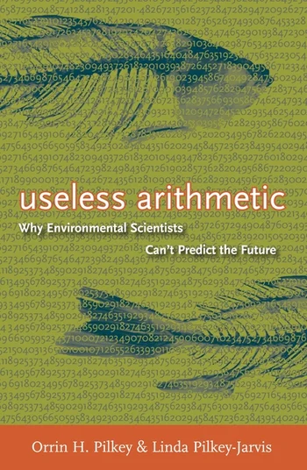
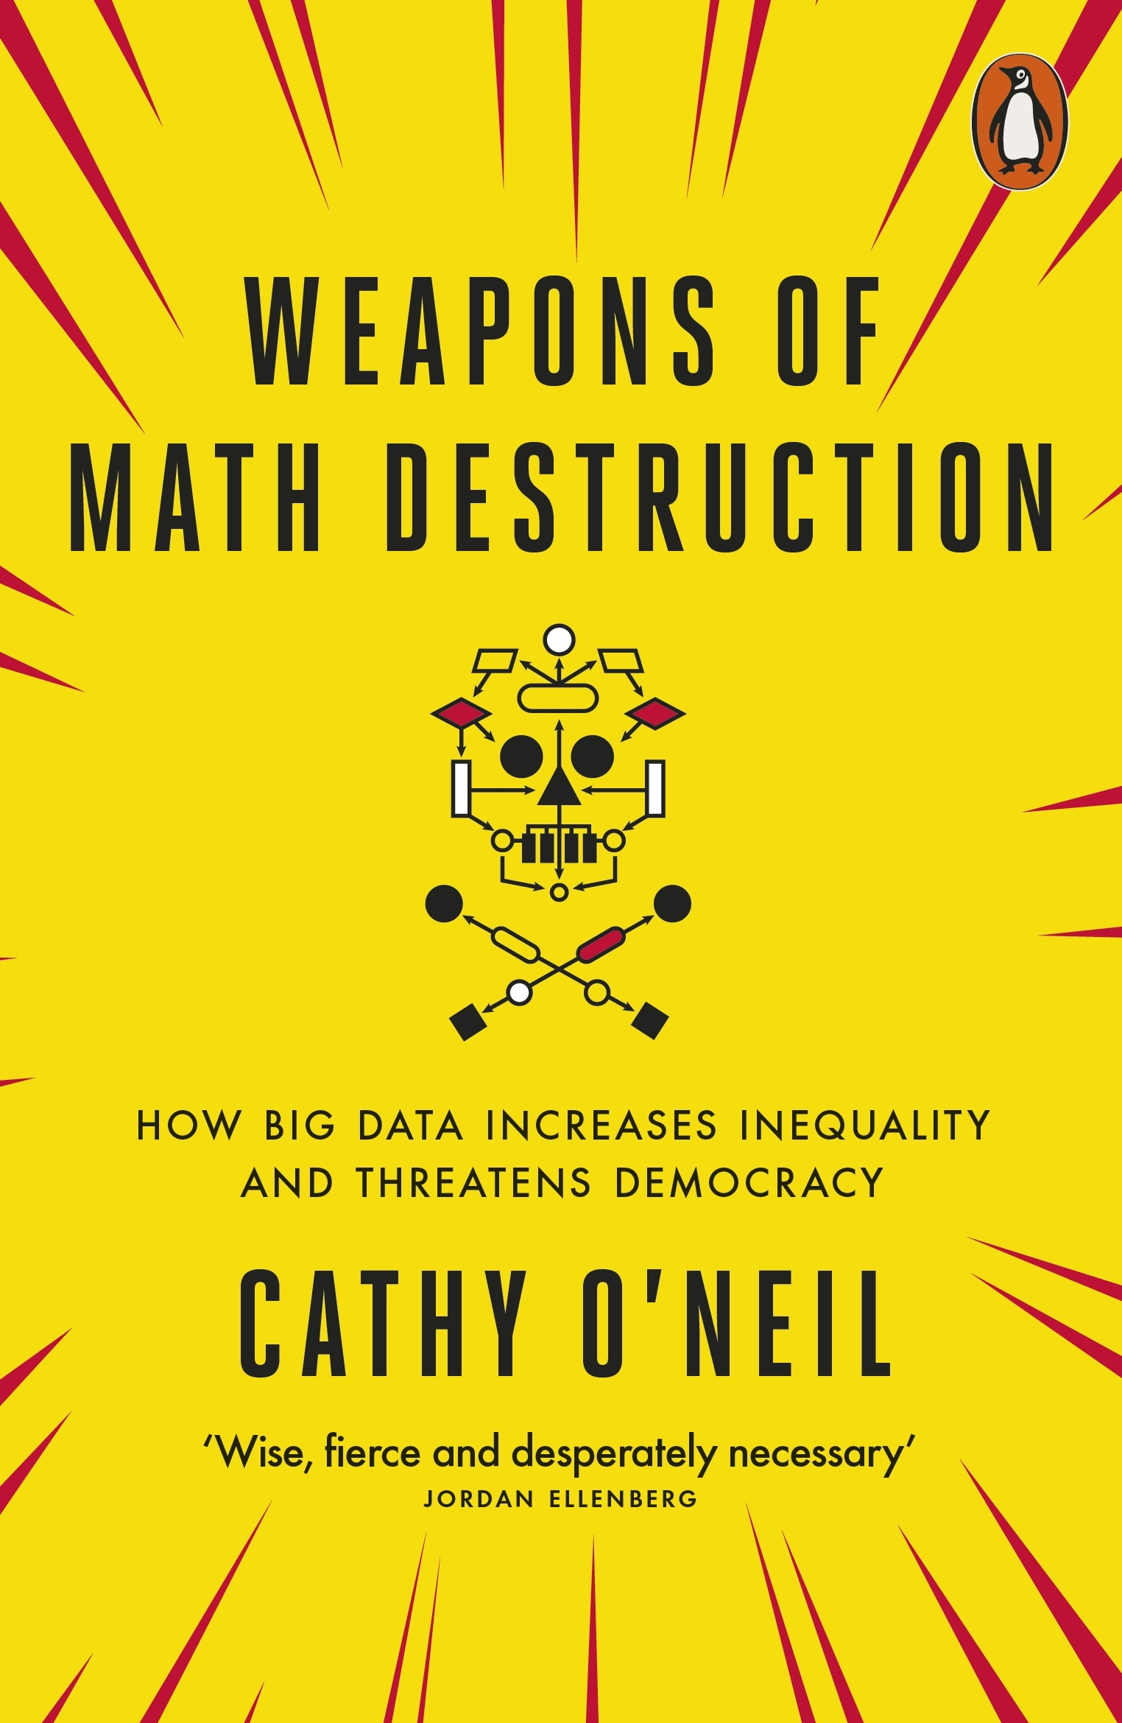

Slide 16
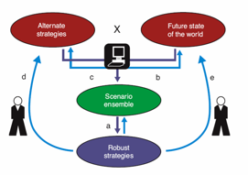
Computer assisted reasoning
Arguments from ensembles
Hypothesis generation
Existence proofs
Non-existence proofs
Reasoning from special cases
Assessing properties of the entire ensemble
Identifying differences that make a difference
Ranking uncertainties
Partitioning uncertainty space

Slide 17
Adaptive planning

Slide 18
Adaptation pathways
Action
A
Time horizon
100
years
Action
B
Pathway
Costs
Benefits
Co
-
benefits
Current
1
+++
+
0
situation
2
+++++
0
0
Action
C
3
+++
0
0
Action
D
4
+++
0
0
Changing conditions
5
0
0
-
0
6
++++
0
-
Time low
-
end scenario
10
70
80
90
100
7
+++
0
-
0
10
100
8
+
+
-
-
-
Time high
-
end scenario
70
80
90
9
++
+
-
-
-
Years
Transfer station to new
policy
action
Adaptation Tipping Point of a
policy action
(
Terminal
)
Policy action
effective

Slide 19
Exploratory scenario thinking

Slide 20
Often, more information can be captured in an ensemble of alternative plausible models than can be captured by any individual model.
Bankes (2002) 10.1073􏰅pnas.092081399

Slide 21
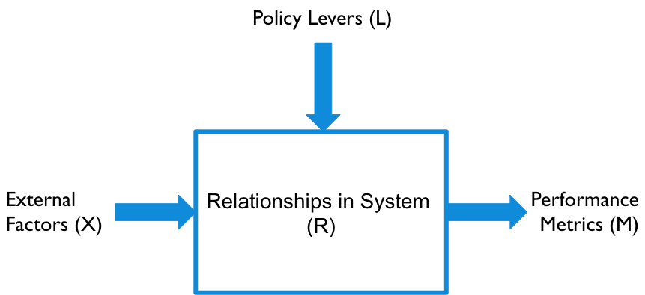
XLRM framework

Slide 22
Running a model as a function
X : uncertainties
Model structure uncertainties as well as exogenous forces
A point in uncertainty space is called a scenario
L : levers
A point in lever space is called a policy
Policies to be tested over the uncertainties
M : outcomes
Outcomes of interest

Slide 23
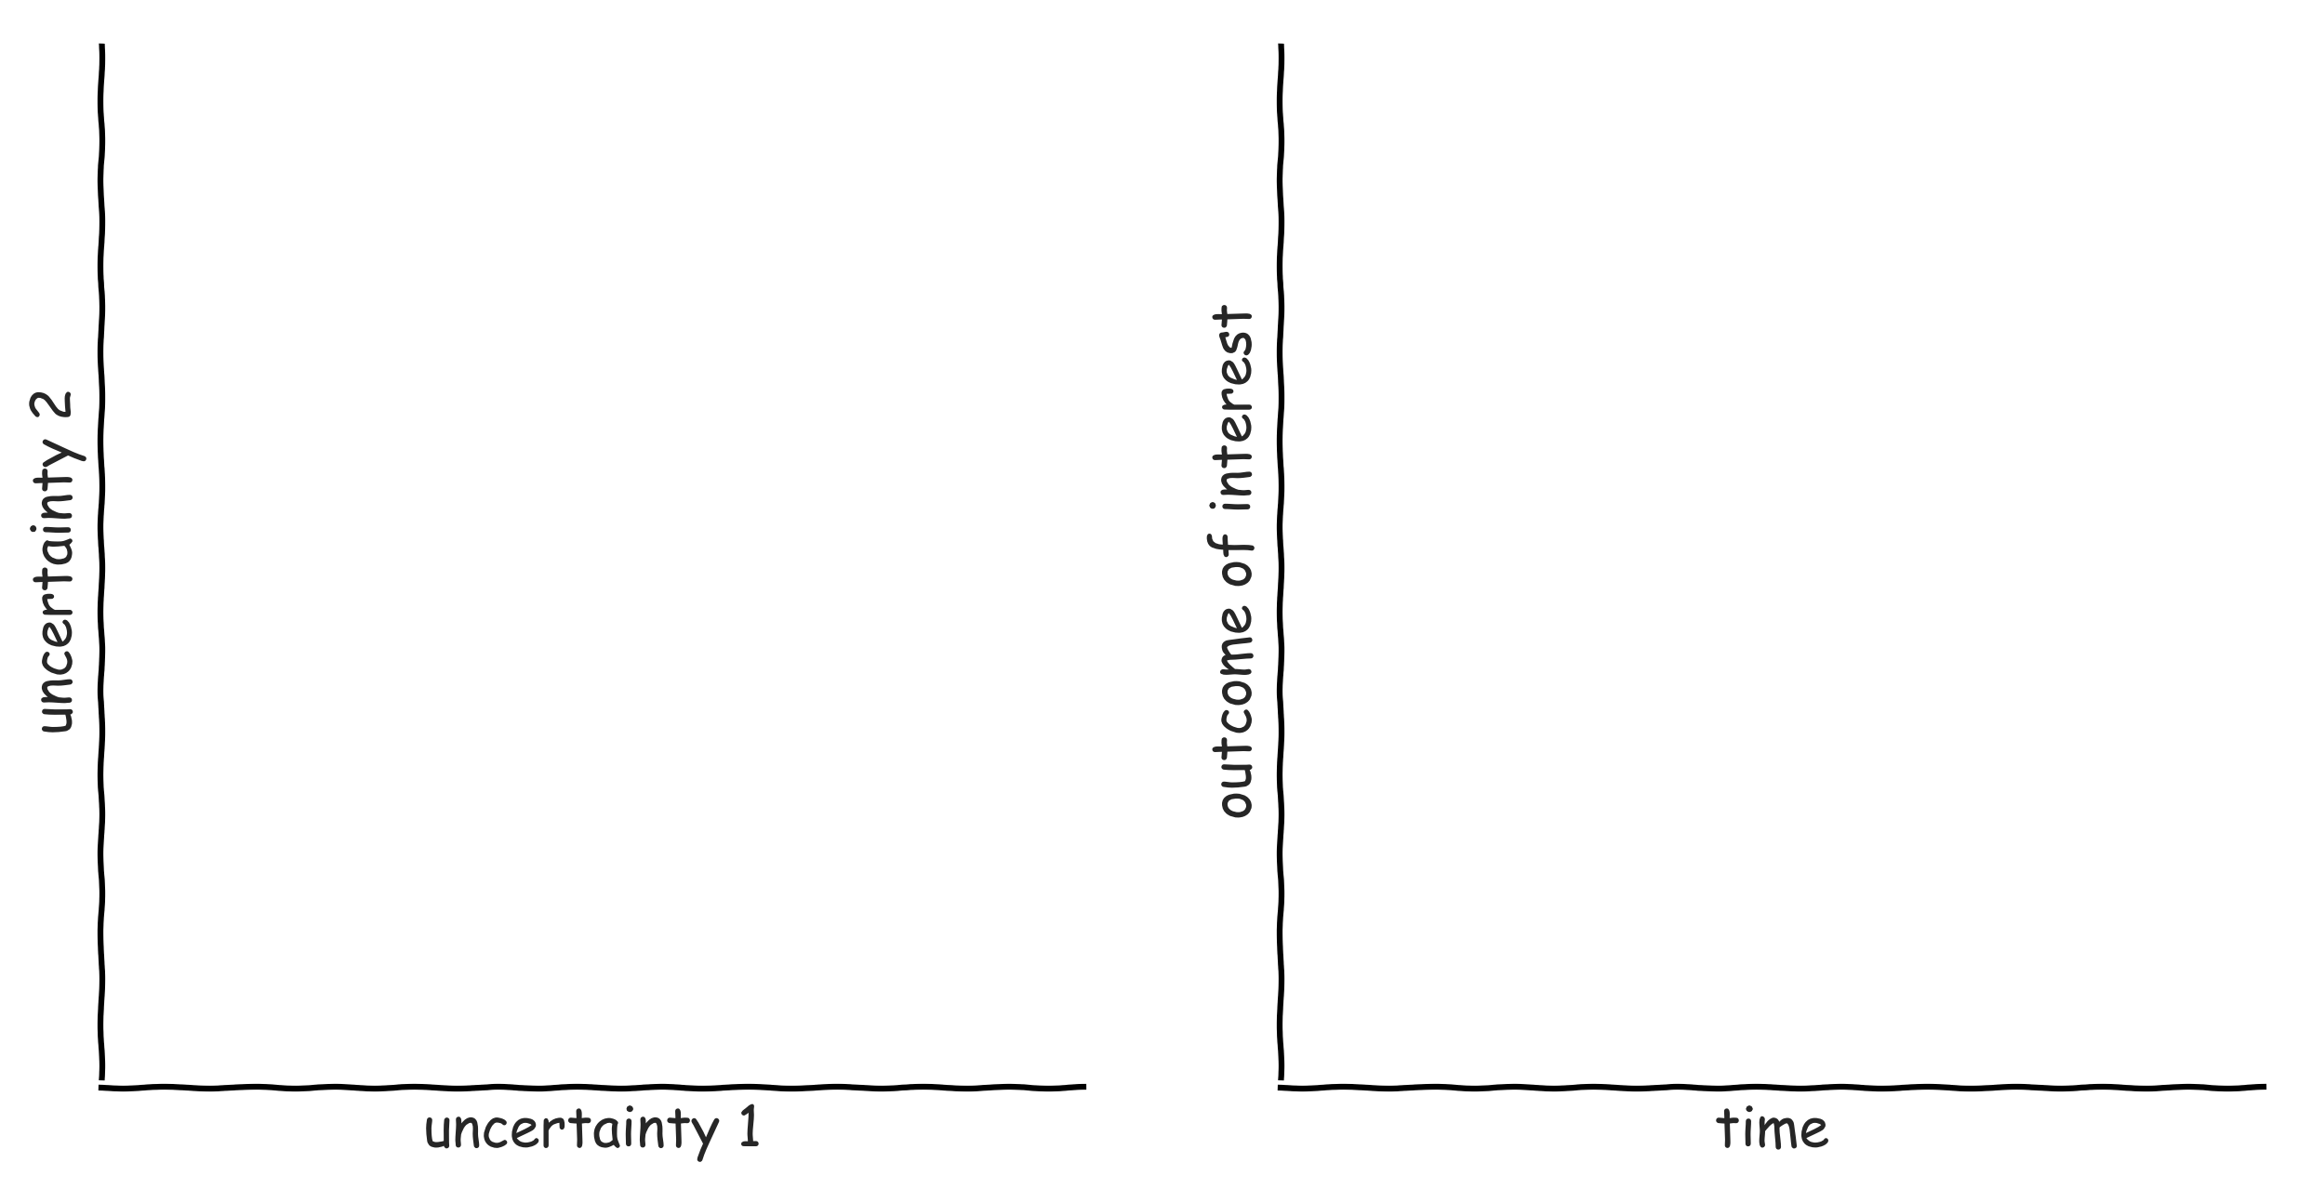
Exploratory modelling in a nutshell

Slide 24
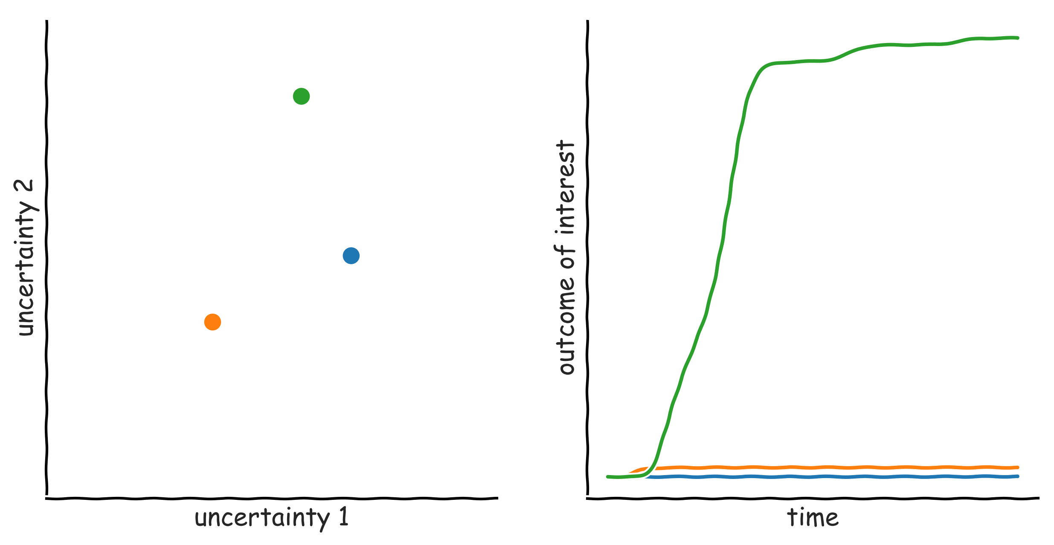
Exploratory modelling in a nutshell

Slide 25
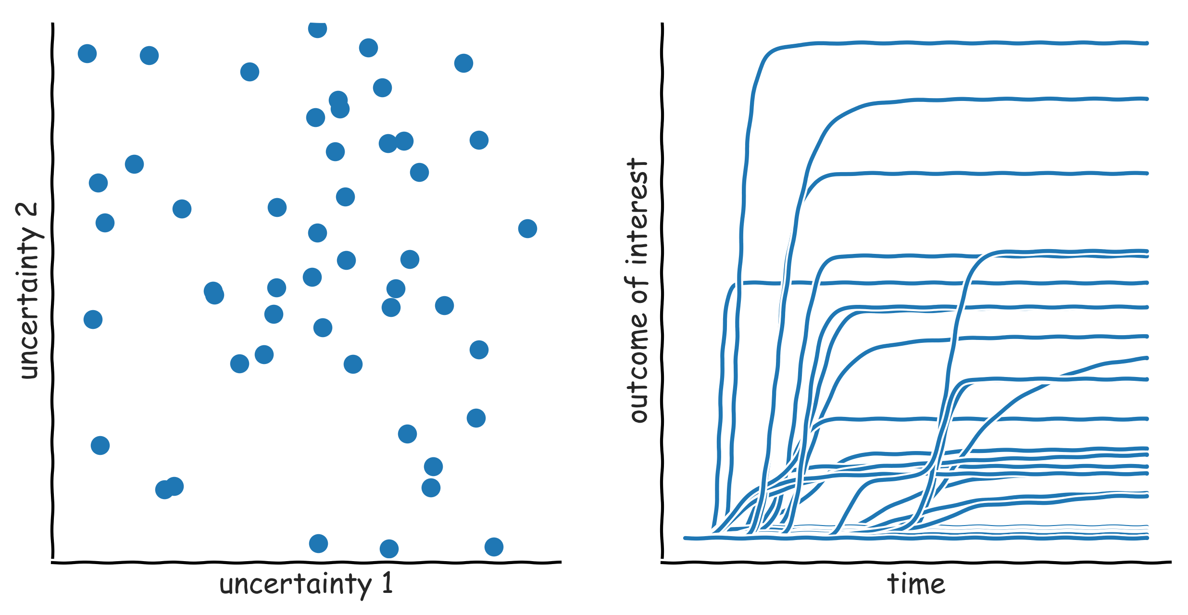
Exploratory modelling in a nutshell

Slide 26
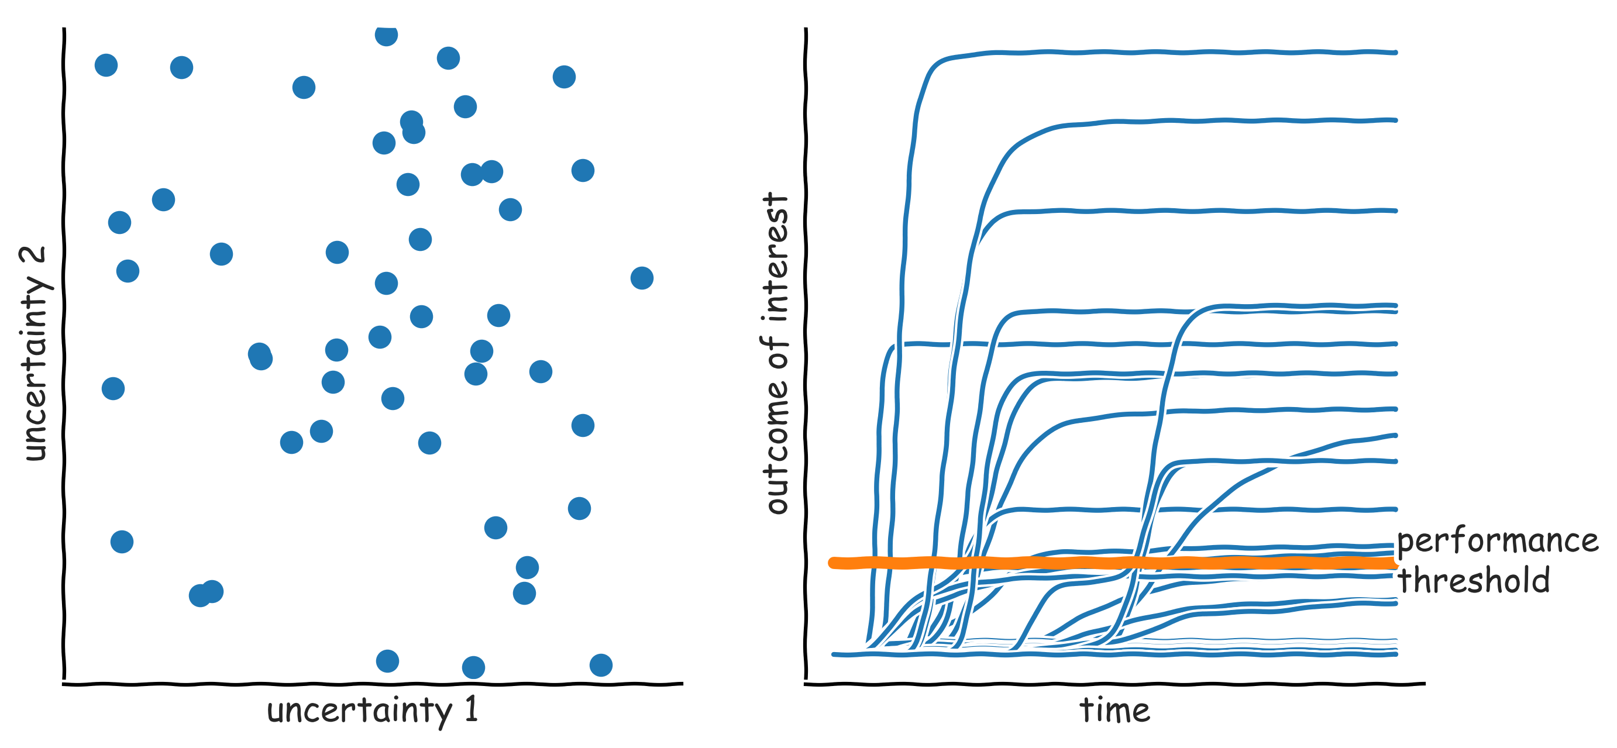
Exploratory modelling in a nutshell: scenario discovery

Slide 27
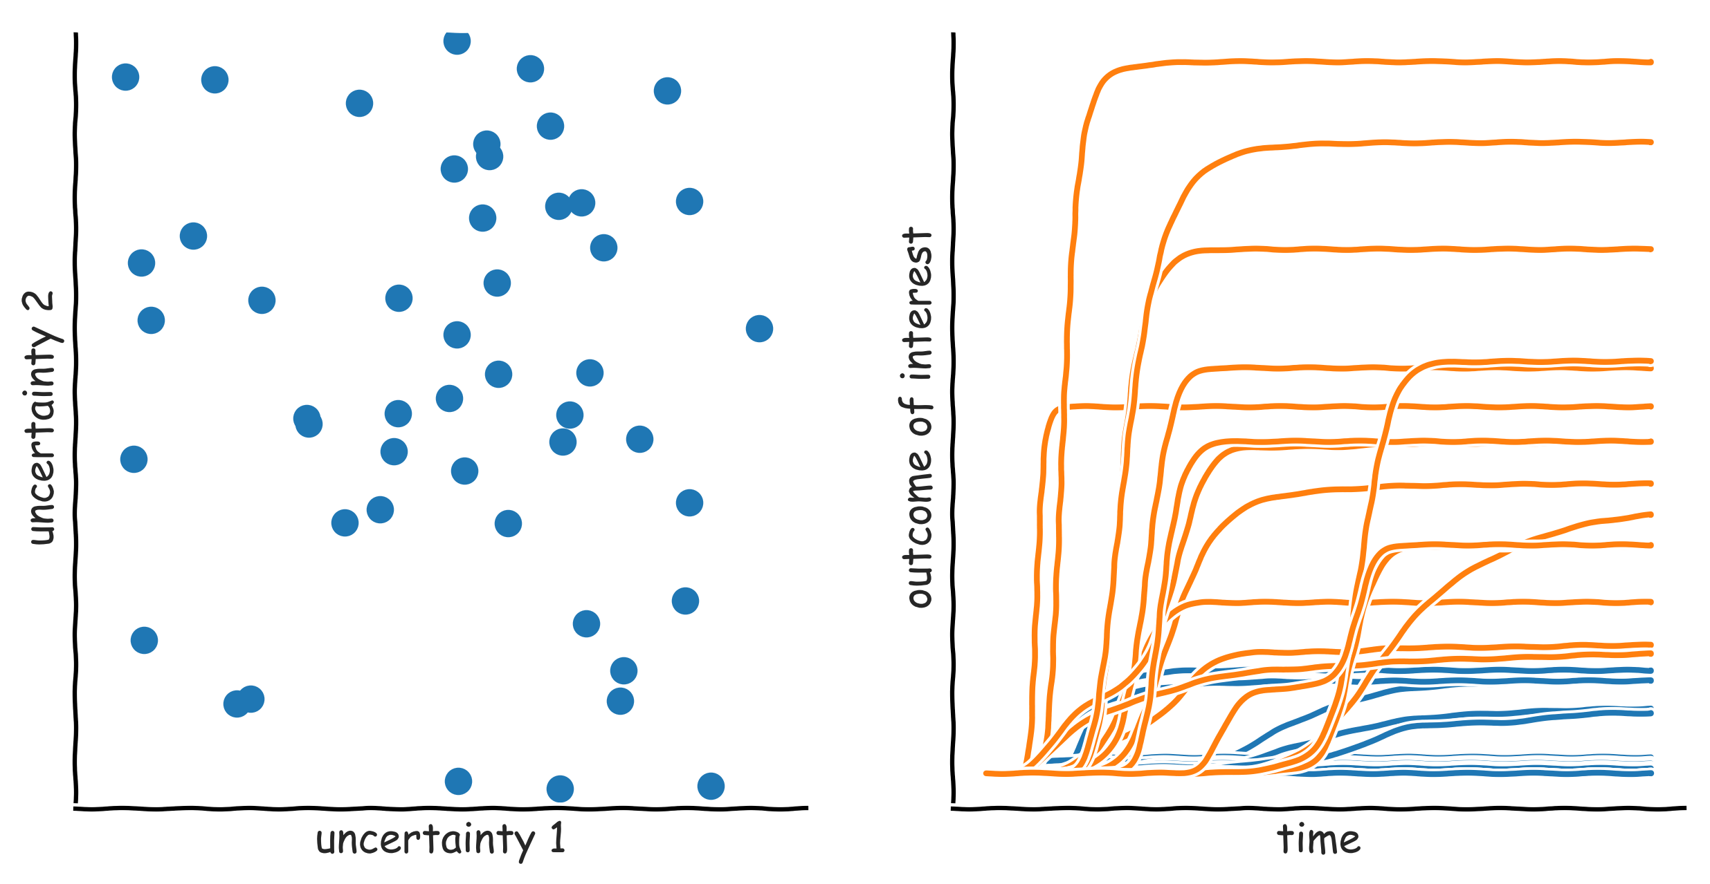
Exploratory modelling in a nutshell: scenario discovery

Slide 28
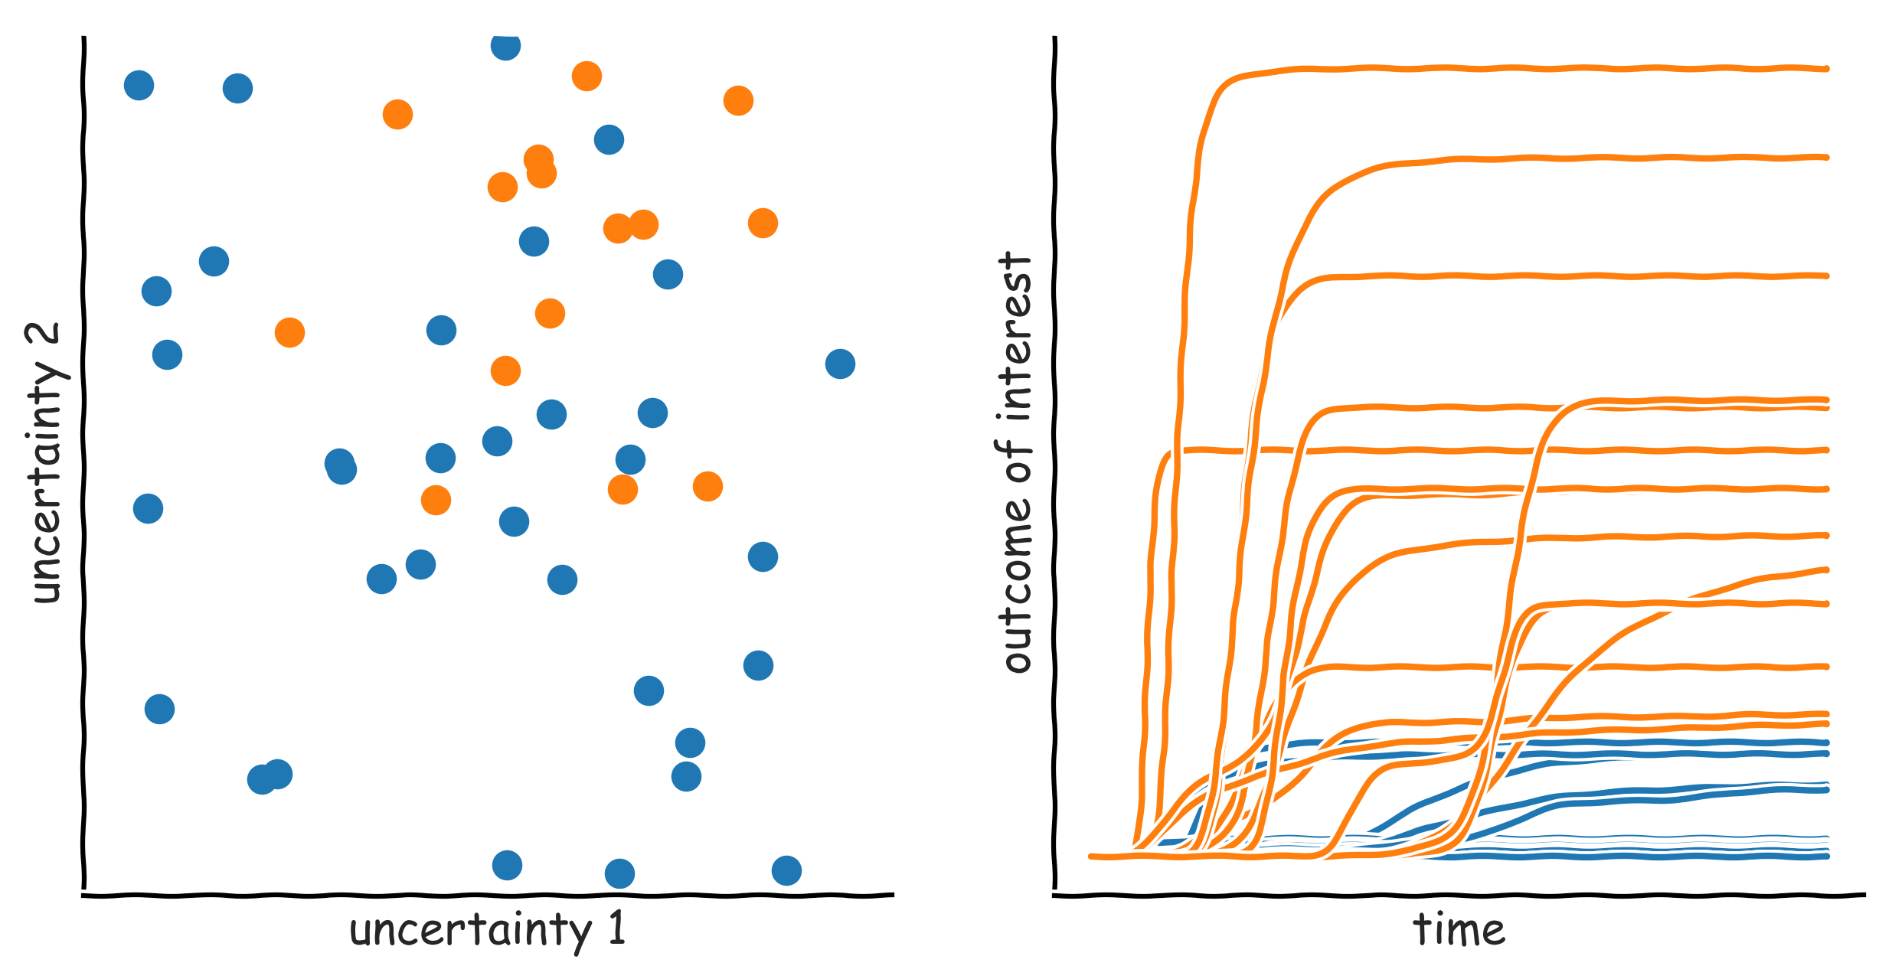
Exploratory modelling in a nutshell: scenario discovery

Slide 29
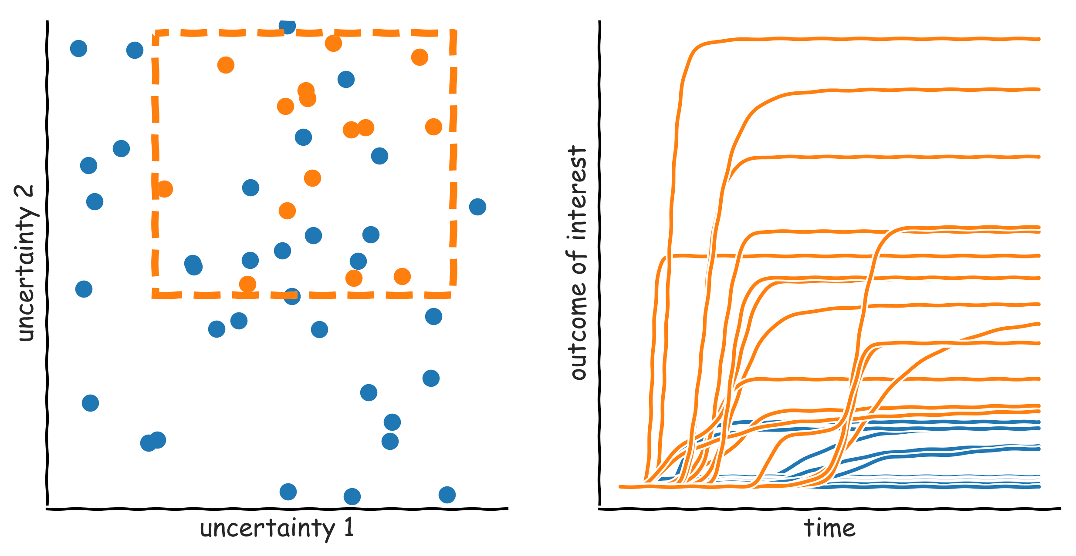
Exploratory modelling in a nutshell: scenario discovery

Slide 30
Manual scenario discovery exercise

Slide 31
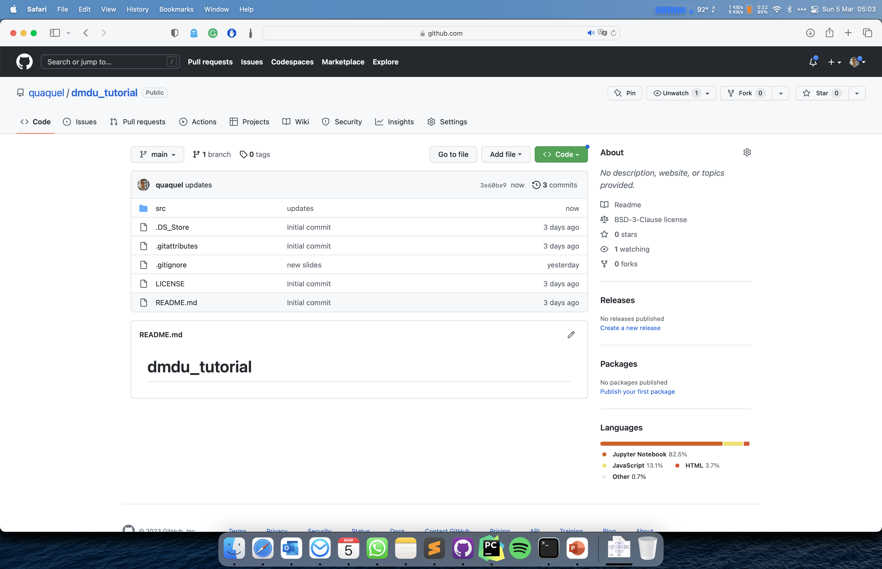
Click and download as zip file

Slide 32
Unzip the downloaded file
Open manual_scenario_discovery.html

Slide 33
Scenario Discovery

Slide 34
Subspace partitioning
Problem: find an (orthogonal) subspace in the model input space, which has a high concentration of cases of interest
Rule induction problem
Regression vs. (binary) classification
Rule induction algorithms
Classification and Regression Trees (CART)
Patient Rule Induction Algorithm (PRIM
Various other more specialized possibilities

Slide 35
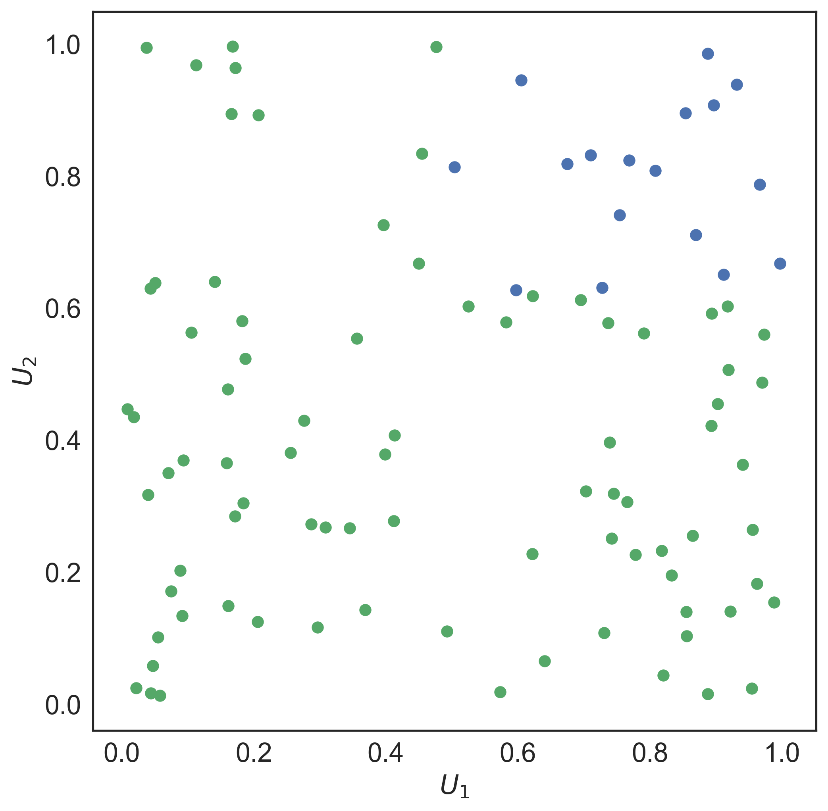
PRIM

Slide 36
PRIM
Lenient hill-climbing optimization algorithm
Each step in the optimization is stored → peeling trajectory
Coverage: fraction of cases of interest within the box
Density: fraction of cases in the box which is of interest
Interpretability: number of restricted uncertainties
Quasi p-values: one sided binomial test, proxy for statistical significance of each restricted uncertainty in isolation
Resampling statistic: do random subsets of the same dataset produce essentially the same box?

Slide 37
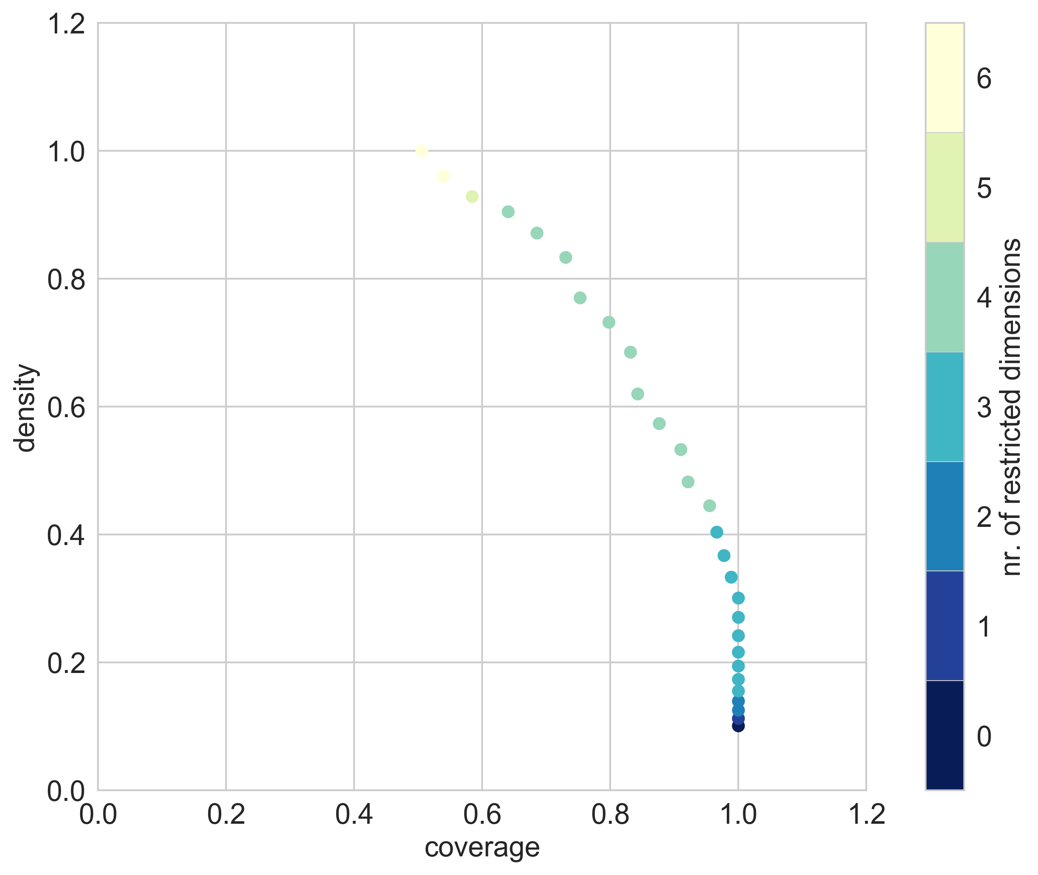

Slide 38
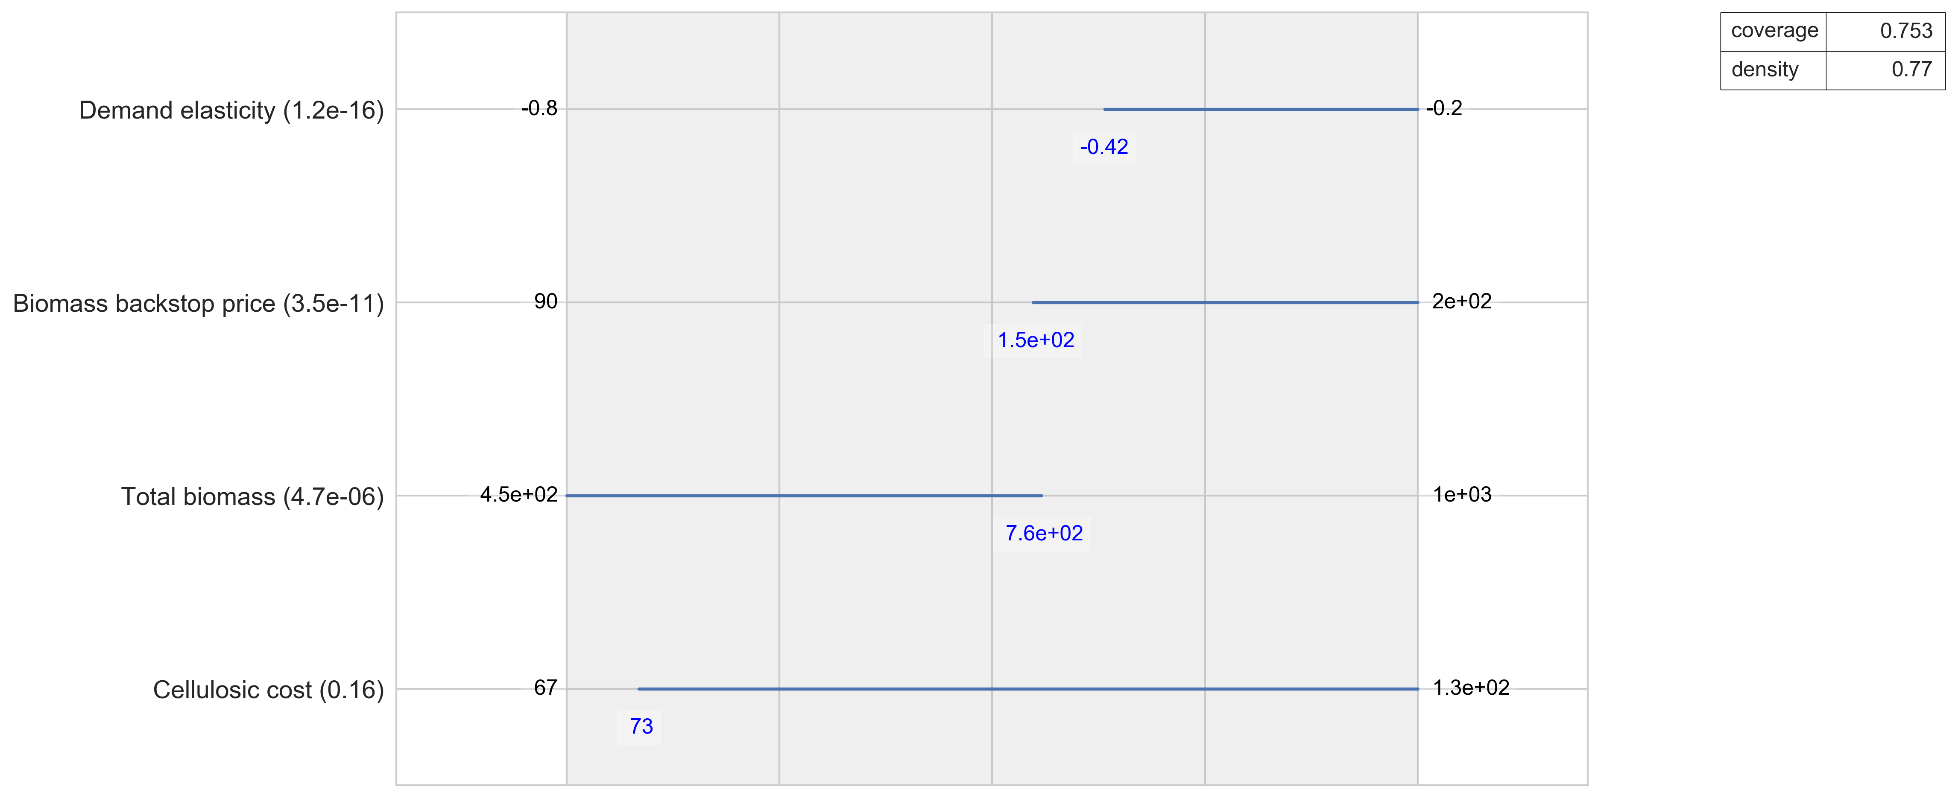

Slide 39
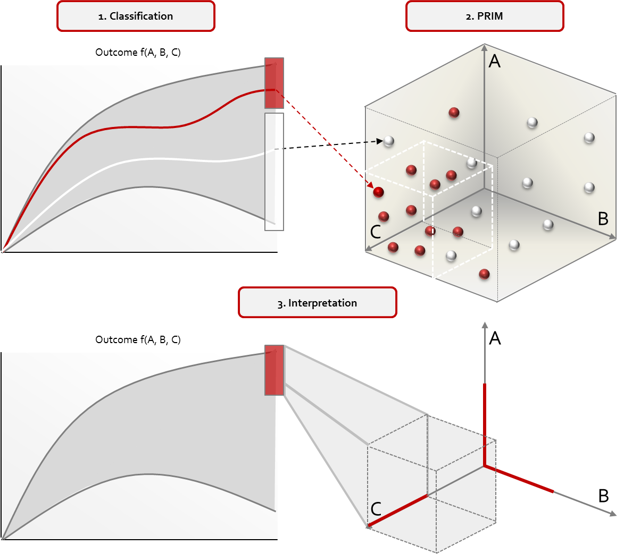
Scenario Discovery

Slide 40
Scenario discovery for designing adaptation pathways
Scenario discovery results can be understood as an n-dimensional generalization of adaptation tipping points
An adaptation tipping point is the level of an exogenous driver at which adaptation is required. These can be mapped to time for different scenarios
Scenario discovery finds n-dimensional boxes in the uncertainty space where a given policy fails
Some caveats
Not all exogenous drivers change over time
Mapping scenario discovery results onto the time axis is an open research question

Slide 41
Scenario Discovery excercise

Slide 42
Working with Google Colab
Go to Google Colab
upload scenario discovery.ipynb
Upload
100 experiments.tar.gz
10000 experiments.tar.gz
Go through the notebook (shift + enter)

Slide 43
EMA workbench: a python library for RDM
Code: https://github.com/quaquel/EMAworkbench
Documentation: https://emaworkbench.readthedocs.io/en/latest/
pip installable
pip install ema_workbench[recommended]

Slide 44
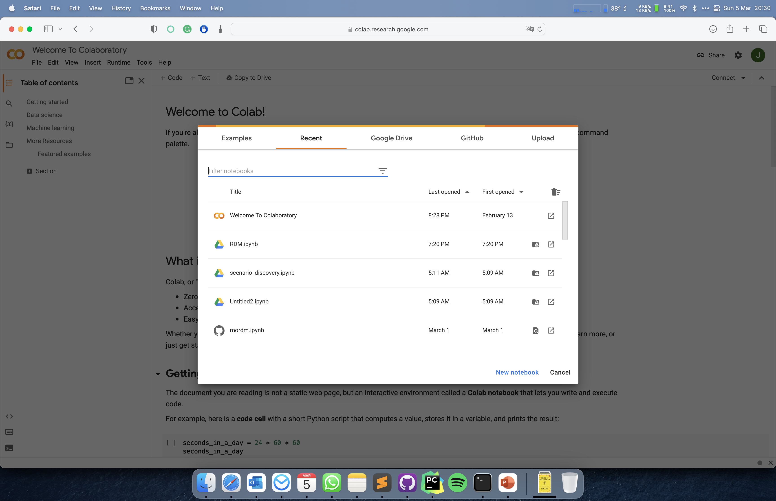
Upload scenario discovery.ipynb

Slide 45
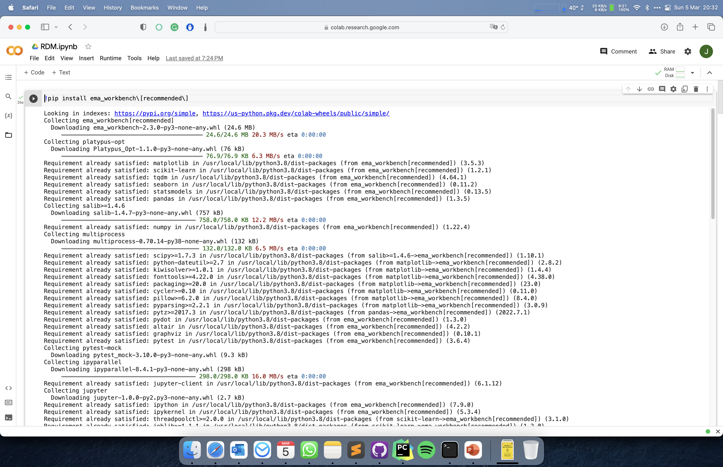
Open file viewer

Slide 46
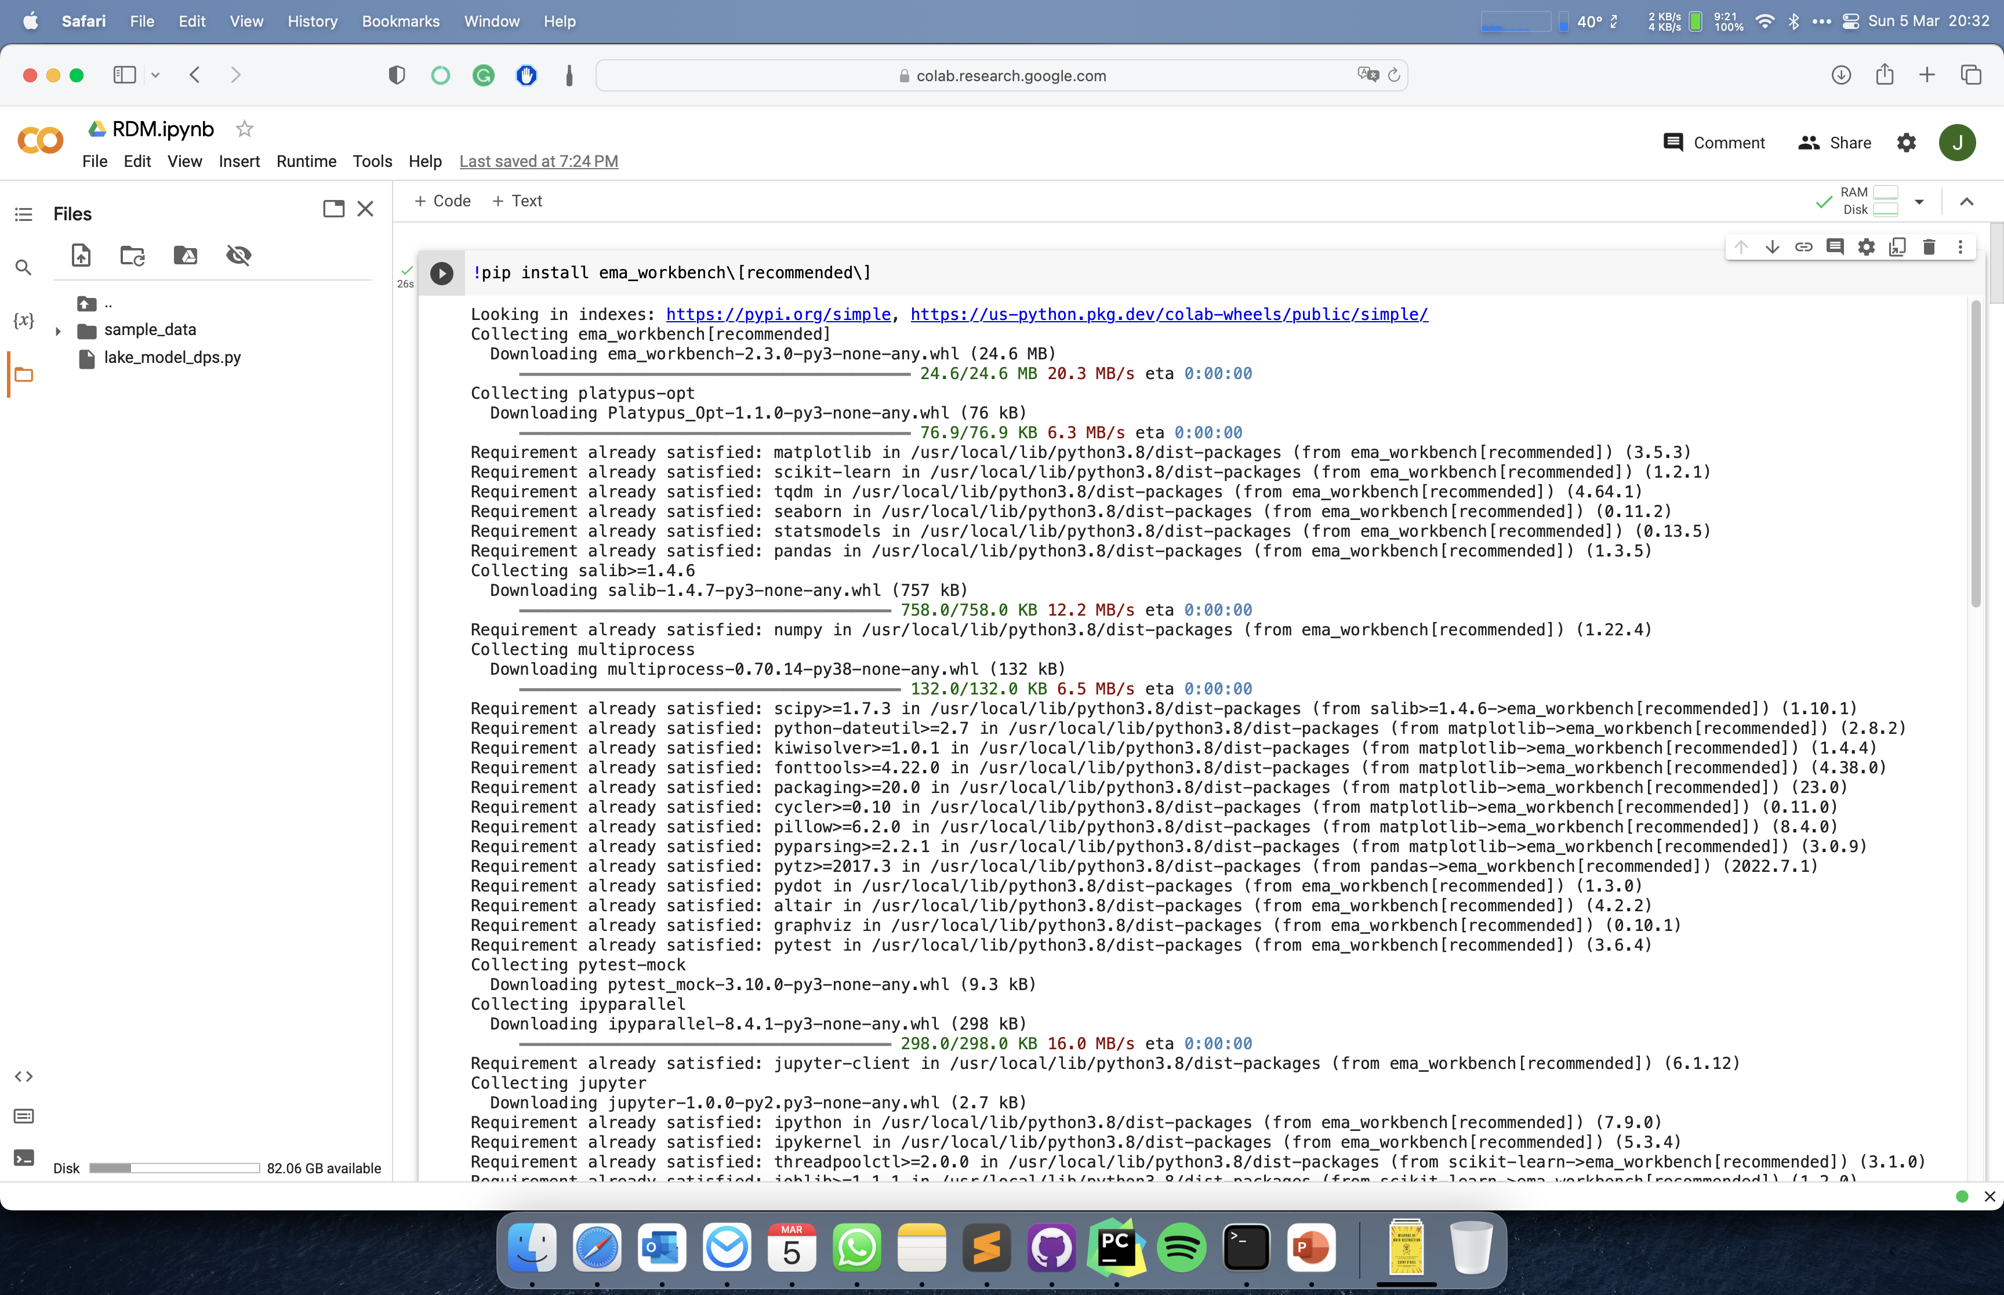
Click upload files

Slide 47
Working with Google Colab
Go to Google Colab
upload scenario discovery.ipynb
Upload
100 experiments.tar.gz
10000 experiments.tar.gz
Go through the notebook (shift + enter)

Slide 48
Introduction to RDM

Slide 49
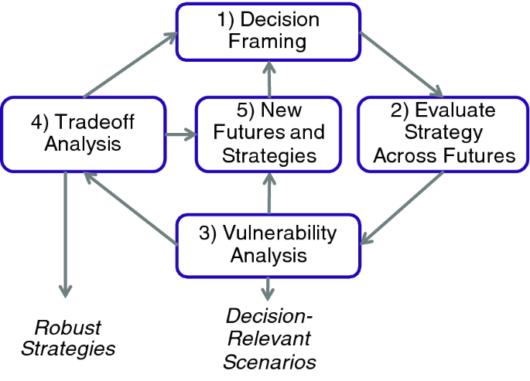
Robust Decision Making
Robust decision making is the process of using computer simulations to iteratively stress test candidate strategies
Decision Framing: structure the decision problem using the XLRM framework
Evaluate strategy across futures: explore behavior of modeled system across the uncertainties for all outcomes of interest, for one or more candidate strategies
Vulnerability analysis: scenario discovery
Tradeoff analysis: if vulnerabilities are limited analyse robustness tradeoffs amongst objectives
New futures and strategies: based on interpretation of 3 and 4, refine XLRM setup

Slide 50
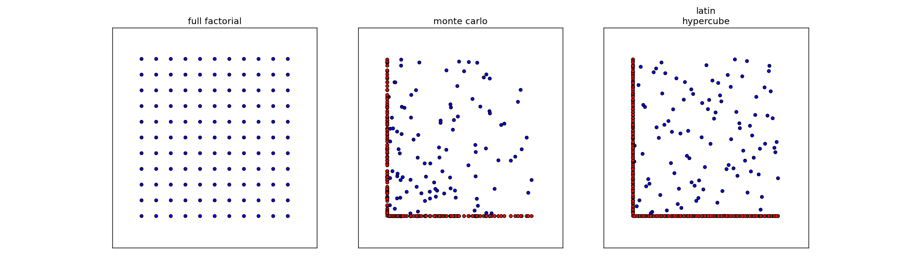
Experimental designs
Notes:
Figures show three sampling strategies with same number of samples (100)
For latin hypercube and monte carlo the red dots show the difference
Problem with full factorial is combinatory explosion.
Problem with lhs is generating it for many cases is memory intensive

Slide 51
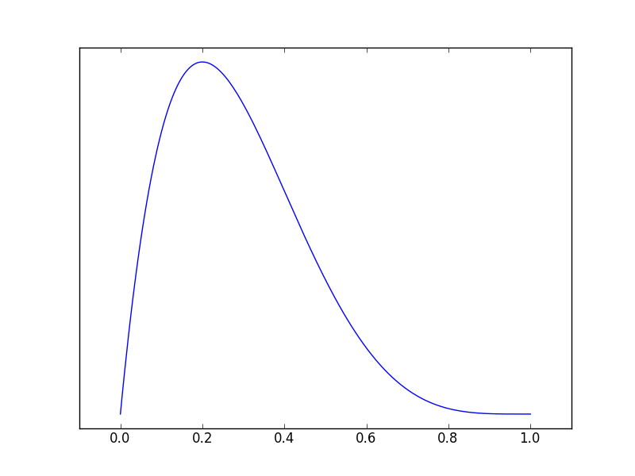
How does a Latin Hypercube work?

Slide 52
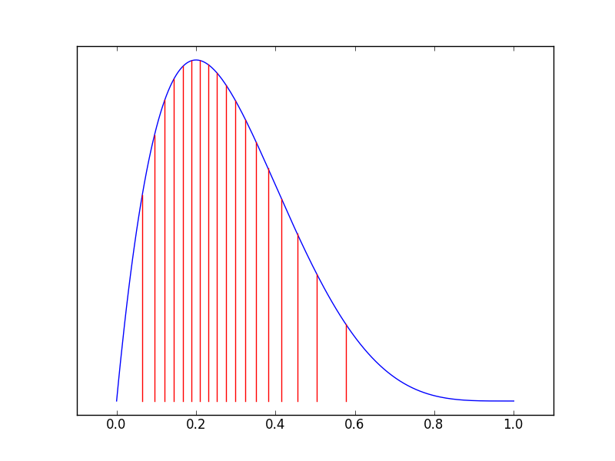
How does a Latin Hypercube work?

Slide 53
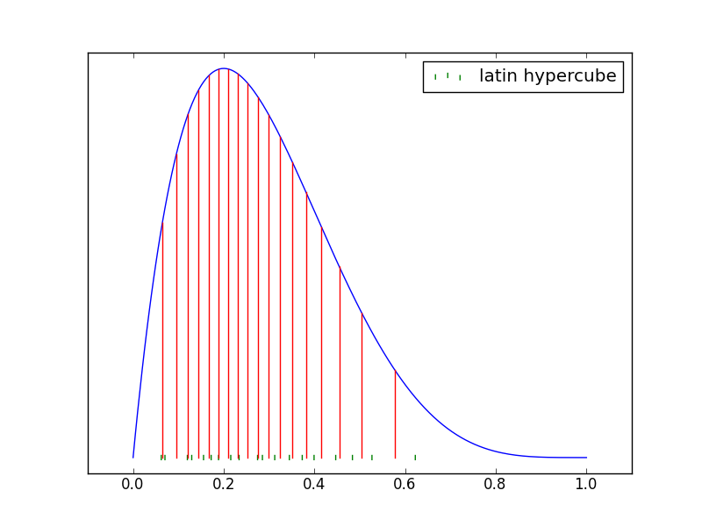
How does a Latin Hypercube work?

Slide 54
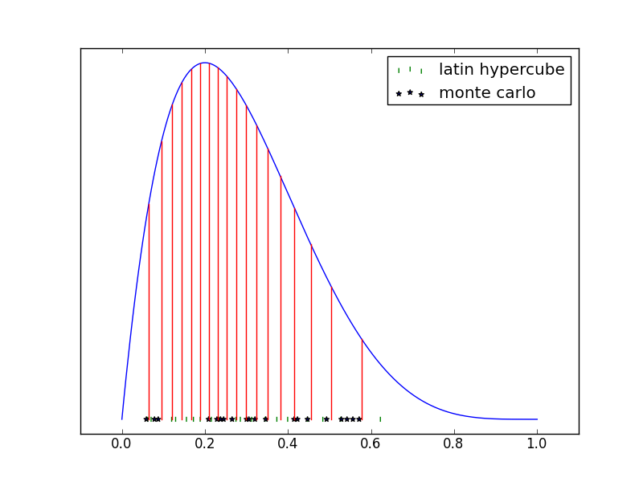
How does a Latin Hypercube work?

Slide 55
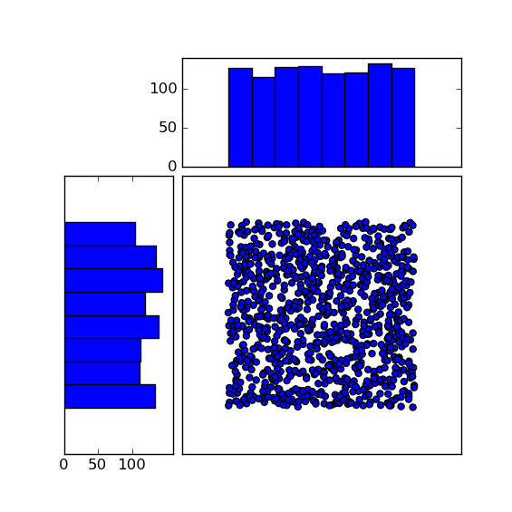
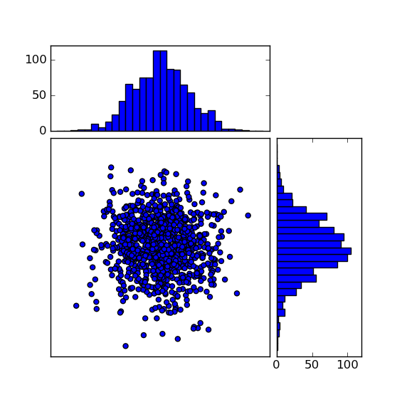
Choosing a distribution
Notes:
Slide shows a pragmatic argument for using a uniform distribution, namely exploring the behaviors a model can exhibit, no attempt is made to try and predict

Slide 56
RDM exercise

Slide 57
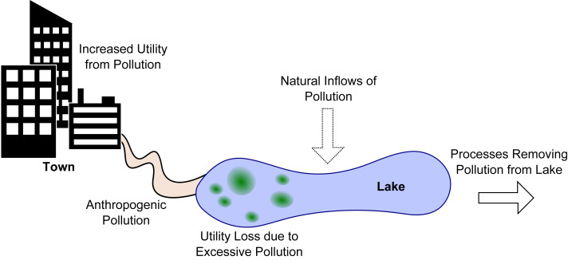
Shallow lake problem
How much anthropogenic pollution to release into the lake, while avoiding that the lake tips into an irreversible eutrophic state?
Adaptive version: what is a state based control rule that tells how much can be released?
Hadka et al (2015). 10.1016/j.envsoft.2015.07.014.

Slide 58
XLRM structuring of shallow lake problem
Levers parameters characterizing the control rule
Uncertainties
b: decay rate
q: recycling exponent
mean: mean of natural
inflows
stdev: stdev of natural
inflows
delta: discount rate
Relations
Outcomes
Maximum pollution level
Utility
Inertia
reliability

Slide 59
Working with Google Colab
Go to Google Colab
upload RDM.ipynb
Upload
lake_model_dps.py
4policies.tar.gz
(optional) lake_1000.tar.gz
Go through the notebook (shift + enter)

Slide 60
Workflow
Connect model to the workbench
X: uncertainties
L: levers which parameterize the control rule
R: model of the shallow lake
M: outcomes of interest
Develop basic system understanding by exploring the behavior of the system for one or more basic policies (i.e. control rules)
Optimize policies for a reference scenario
Re-evaluate (selected) policies over a much larger ensemble of scenarios
Analyze robustness and vulnerabilities (i.e., scenario discovery)
Iterate if necessary

Slide 61
Robustness metrics

Slide 62
McPhail, C., et al (2018). "Robustness metrics: How are they calculated, when should they be used and why
do they give different results?" Earth's Future. 10.1002/2017EF000649

Slide 63
Robustness metrics
deeply uncertain factor 1
deeply uncertain factor 2
deeply uncertain factor 3
KPI’s per
scenario
Distribution per kpi over scenarios
policy
How to summarize the distribution over scenarios in (preferably) one number?
Robustness per kpi, or one robustness number per policy?
Figure adapted from Trindade et al. (2019) https://doi.org/10.1016/j.advwatres.2019.103442

Slide 64
3 families of robustness metrics
Satisficing robustness
Absolute: the observed performance of a policy in each scenario compared to an absolute performance threshold
Regret
Relative: the difference between the observed performance of a policy in each scenario and the performance of some reference policy for each scenario
Descriptive statistics
Characterizing the distribution of performance of a policy over the set of scenarios using one or more moments of the distribution

Slide 65
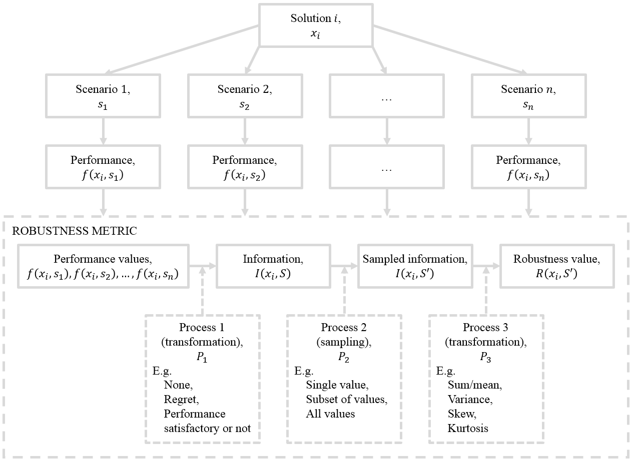
Robustness calculation
McPhail, C., et al (2018). "Robustness metrics: How are they calculated, when should they be used and why
do they give different results?" Earth's Future. 10.1002/2017EF000649

Slide 67
MORDM exercise continued

Slide 68
Example: Competitive position of the Port of Rotterdam

Slide 69
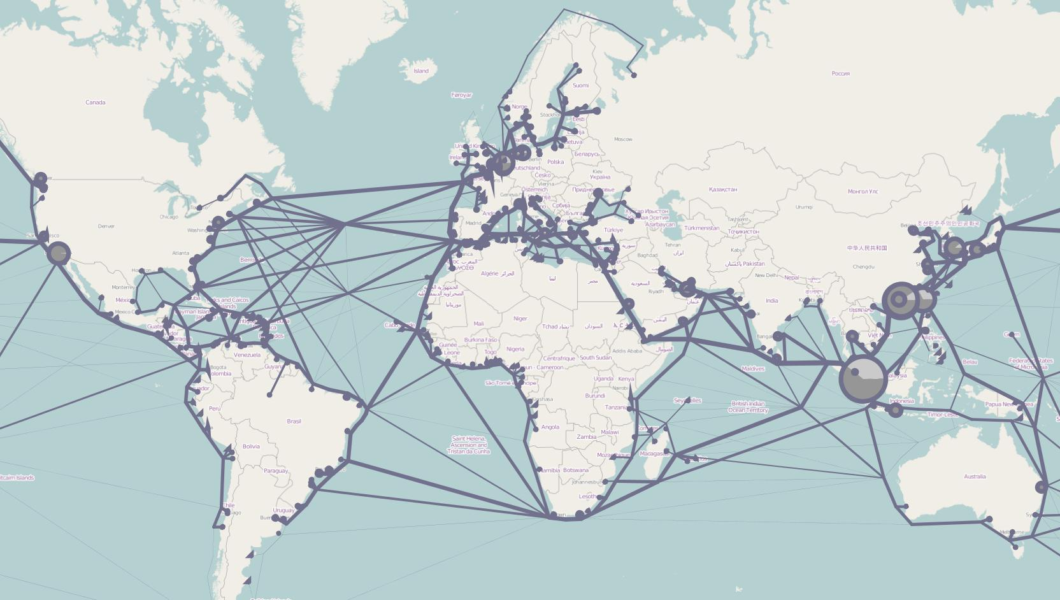
The world container model
Tavasszy, L. A., Minderhoud, M., Perrin, J.-F., & Notteboom, T. (2011). A strategic network choice model for global container flows: specification, estimation
and application. Journal of Transport Geography, 19, 1163–1172

Slide 70
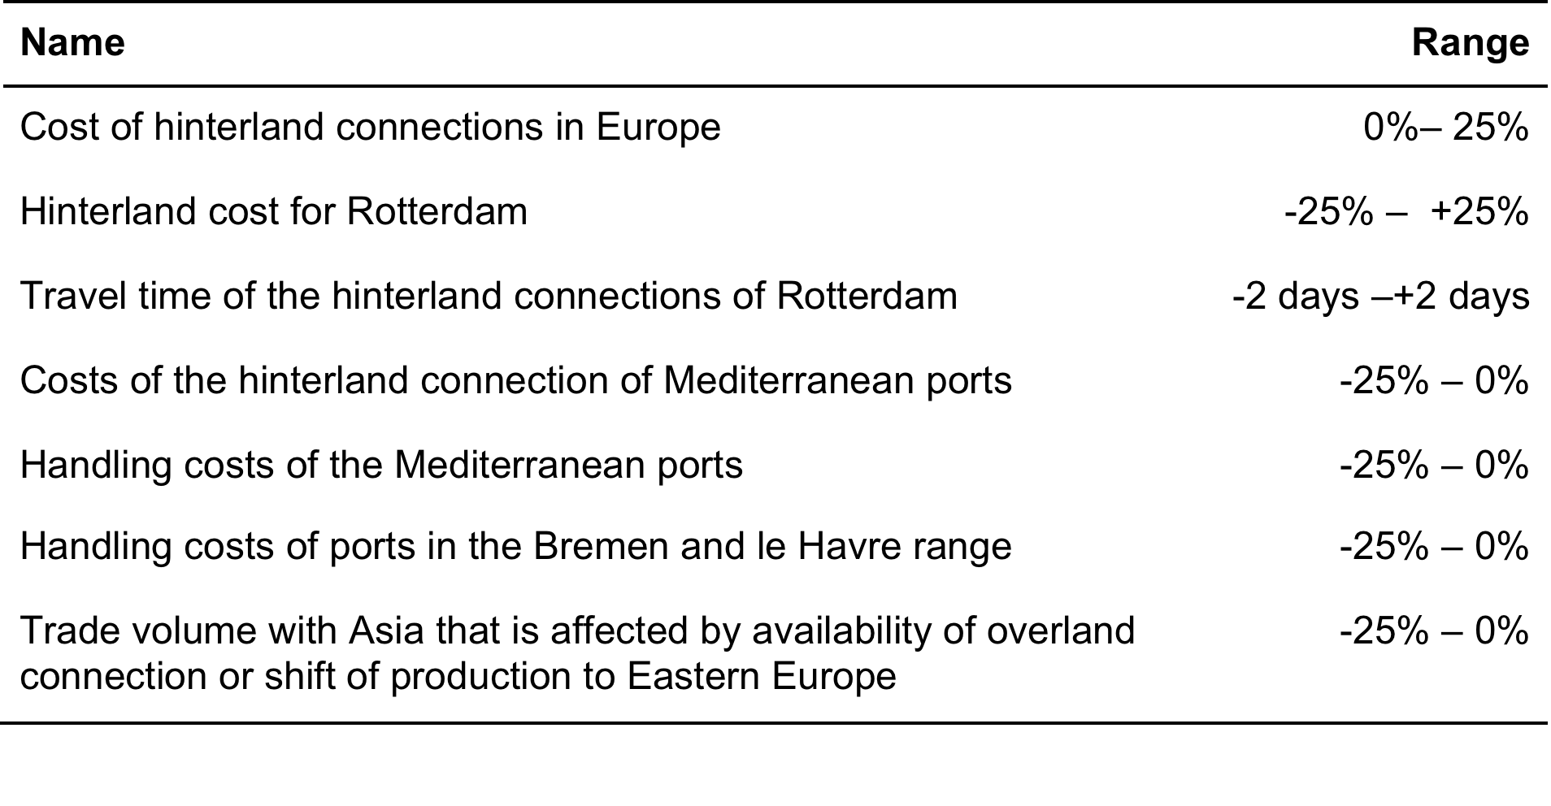
Major uncertainties that might impact the port of Rotterdam

Slide 71
Identification of vulnerabilities under what conditions does Rotterdam lose throughput?

Slide 72
Identification of vulnerabilities under what conditions does Rotterdam lose throughput?
Increase of costs on all hinterland connections for ports in the Hamburg – le Havre range
More than 1 additional day required for shipping from Rotterdam
No substantial decrease in hinterland transport costs for Rotterdam
Together, these 3 factors explain 75% of the cases where Rotterdam loses throughput, with 71% accuracy

Slide 73
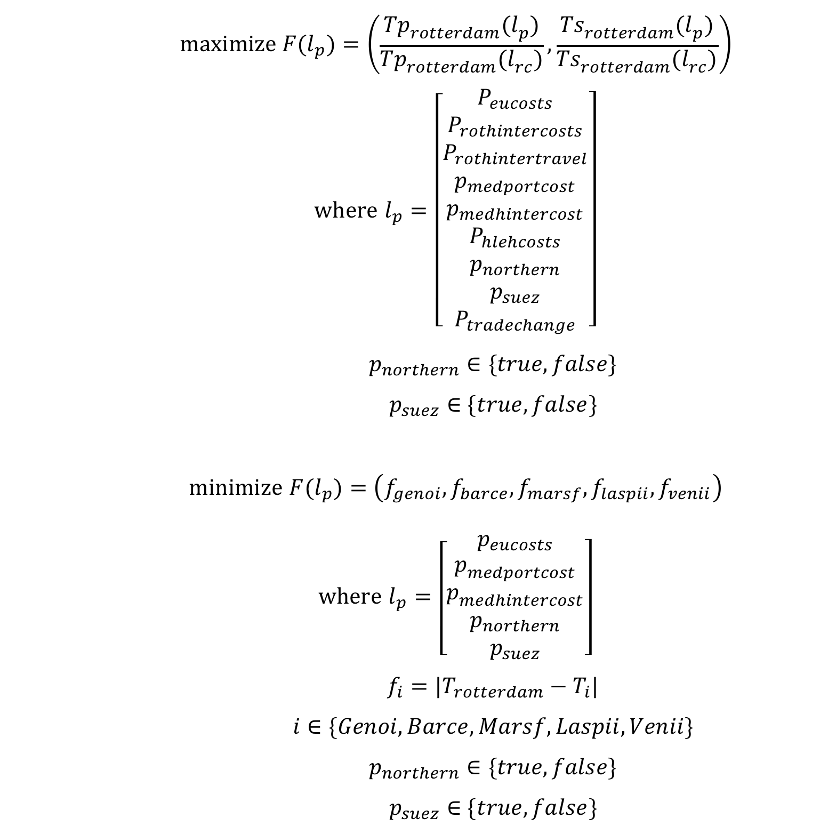
Worst case discovery
Is there a perfect storm scenario?
No, small changes in the uncertain factors do not lead to large change in throughput or transshipment

Slide 74
Worst case discovery
Is there a perfect storm scenario?
No, small changes in the uncertain factors do not lead to large change in throughput or transshipment
Under what conditions do the Mediterranean ports become competitive?
Substantial increase in EU hinterland costs, substantial reduction in port handling costs and hinterland transport costs and time for Mediterranean ports, and the opening of the Northern passage
Limitation: shipping line network structure is kept static

Slide 75

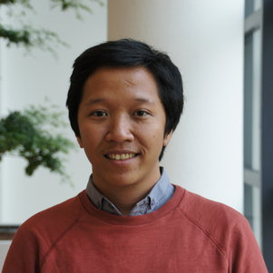

Income inequality in the Vietnam Mekong Delta
Bramka Arga Jafino
Maaike van Aalst
Notes:
Many talk about climate migration from the mekong
But real story is quite more complicated
So we created a simulation model to better understand what is happening and to identify possible interventions that address inequality

Slide 76
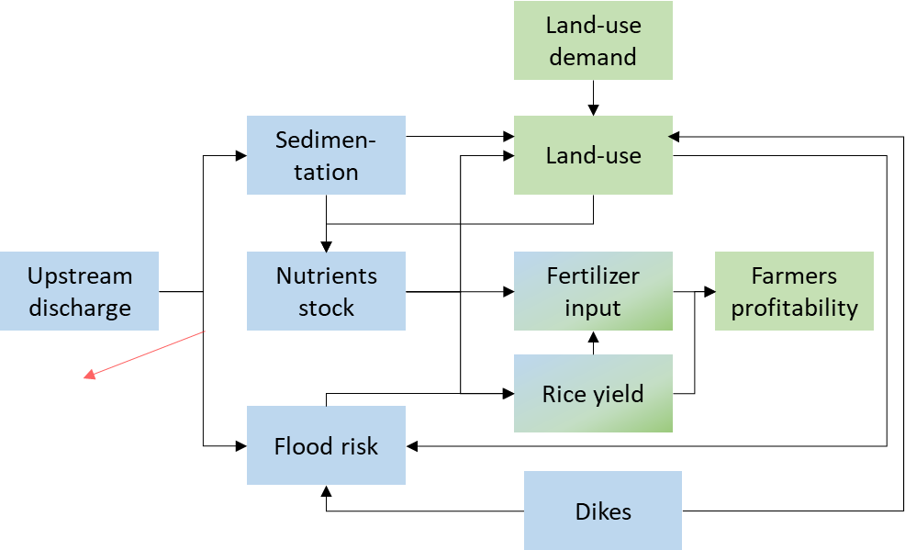
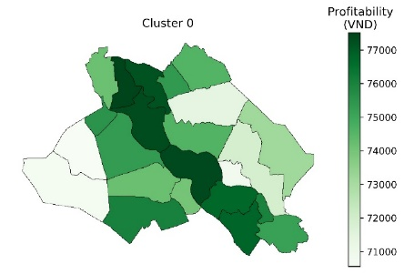
Adaptation policies
more high dikes
less high dikes
fertilizer subsidies
seed upgrade
Uncertainties
river discharge
upstream dam development
farming preferences
drought impacts
Performance indicators
District level profitability
Integrated assessment model
Notes:
Walk through the modeling work

Slide 77
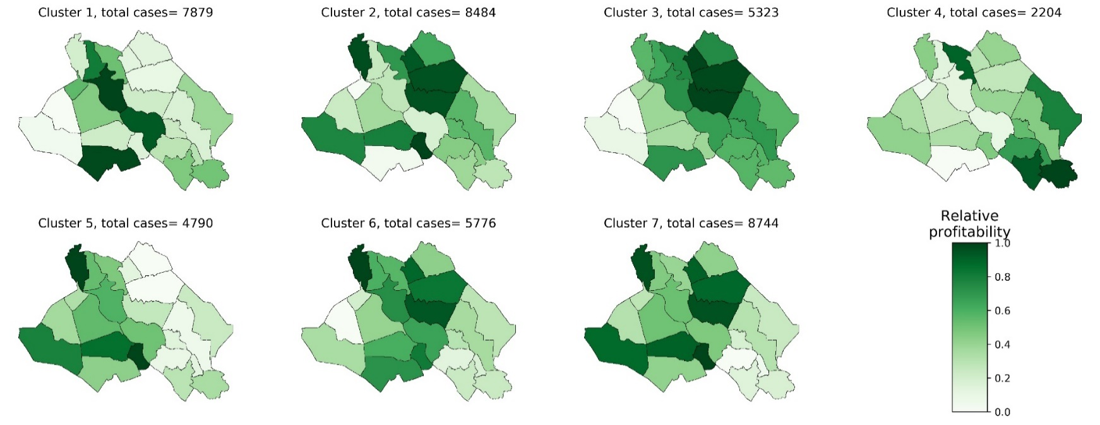

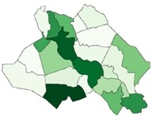
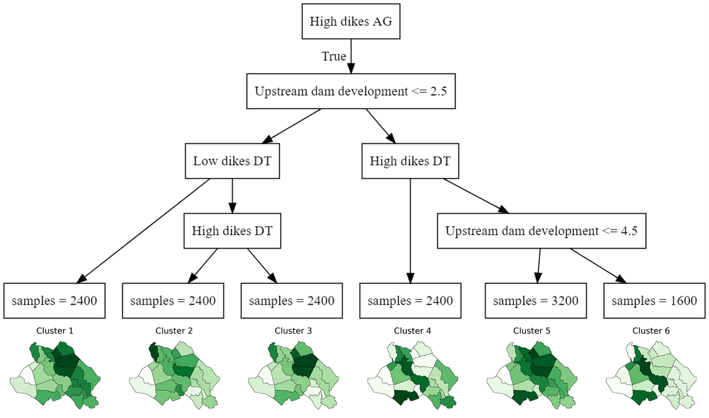
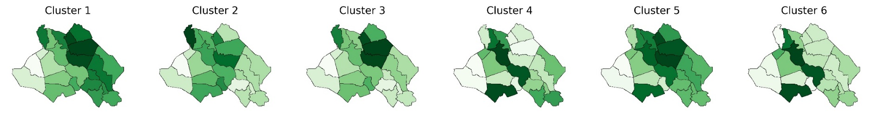
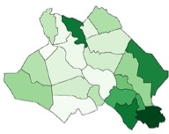
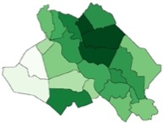


How can income patterns change?
43K scenarios
7 archetypical
income patterns
Classification tree mapping uncertainties and policies to types of income patterns

Slide 78
How can income patterns change?
43K scenarios
7 archetypical
income patterns
Classification tree mapping uncertainties and policies to types of income patterns

Slide 79

How sensitive are rankings to normative assumptions?

Slide 80
Closing remarks

Slide 81

Kwakkel & Haasnoot (2018) Supporting decision making under deep uncertainty: a synthesis of approaches and techniques

